Slide 2
Mobile Steam Unit The next generation in Well Rehabilitation
What is the Mobile Steam Unit?

Slide 3
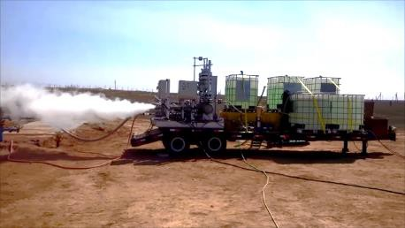
Mobile Steam Unit
Cutting Edge Advanced Technology
New and totally green technology:
Produces steam through the exothermic reaction from the decomposition of Hydrogen Peroxide (H₂O₂) When exposed to the specially designed and patented MSU catalyst.

Slide 4
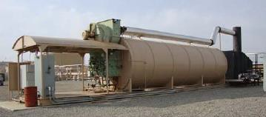
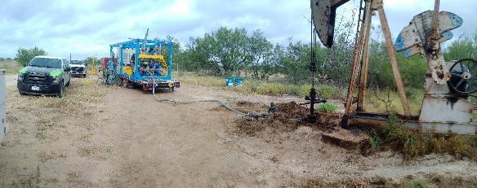
MSU Eliminates ALL Historical Limitations for Well Steaming
No fuel fired boilers
No local water source
No water treatment
No fixed facilities
No air and water permits required
Highly mobile
One MSU can treat multiple wells and pipelines per day

Slide 5
Elimination of dehydrated oil deposits
The Mobile Steam Unit produces high pressure and temperature steam
This steam can be utilized in the elimination of built up oil, wax and paraffin deposits in:
Well production tubing
Flow lines, and
Header manifolds
Reducing significant back pressure on the reservoir

Slide 6
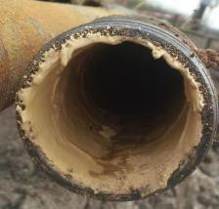
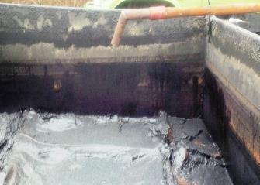
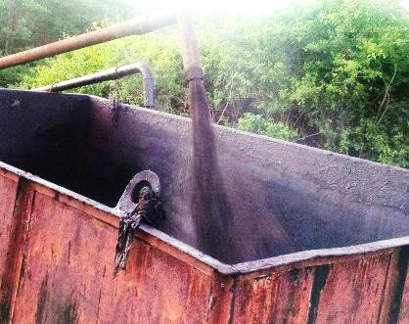
Hungary results Feb, 2016
Before
After

Slide 7
Hydrogen Peroxide: Background
Hydrogen Peroxide is used extensively worldwide
50% of the world's production of hydrogen peroxide is used for pulp and paper bleaching
Other uses include:
BOD and COD removal in wastewater
Antimicrobial agent in hospital environments
Laundry Bleach
Concentrated H2O2 (>90%) is used as a propellant in rocketry (Germany WWII, NASA, etc.)
Hydrogen peroxide decomposes exothermally into water and oxygen gas: 2 H2O2 → 2 H₂O₂ + O2+
The heat produced from the reaction turns the water into steam:

Slide 8
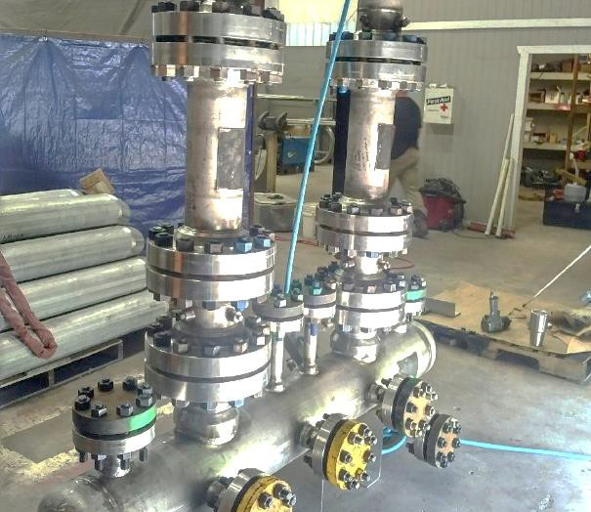
State of the art Engineering
The Mobile Steam Unit can produce and maintain steam temperatures up to 500°F (260°C) with flow rates up to 10,000 Gal/day (40M³/day).
It’s components have been designed to handle pressures up to 1,500 psig (100 atm)

Slide 9
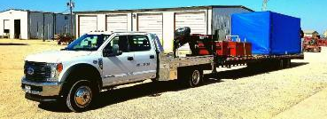
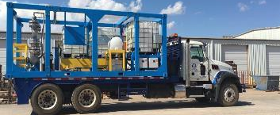
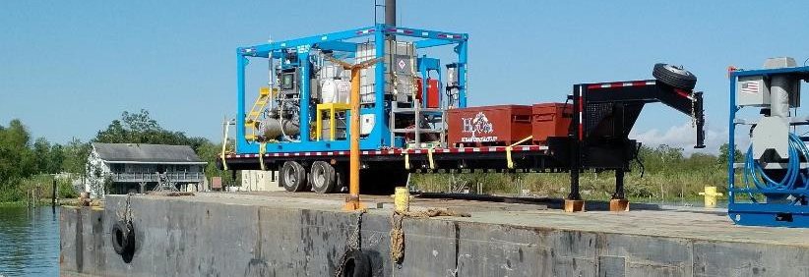
Pressure Vessels have ASME U stamp
Steam flow, temperature and pressure can be adjusted depending on:
Physical limitations of the oil producing equipment,
Characteristic of the formation,
Environmental requirements,
Gravity of the oil and steaming method used (cyclical or steam flooding injection)

Slide 10
Safety & Environmental
The Mobile Steam Unit can operate with industrial grade peroxide concentrations as low as 50%. Depending on local regulations, economies and client requirements, concentrations up to 70% can be used.
Internal procedures have been developed following H₂O₂ manufacturers and OSHA Guidelines to safely handle and transport Hydrogen Peroxide on roads, by rail and vessels (If higher international or local standards are required the MSU team will endeavor to meet them).
The H₂O₂ is the only product used in the reaction
The only emissions from the reaction are steam (H₂O) and Oxygen (O₂)
If required, free O₂ can be converted to CO₂ with pre-additives
Xtreme Performance Chemicals’ personnel are trained to safely transport, store and utilize H₂O₂

Slide 11
Safety & Environmental
In comparison to conventional oil heaters or steam generators, the MSU DOES NOT REQUIRE:
Surface structures (No footprint)
Boiler
Treated or untreated water supply
Diesel / Propane fuel supply
Electricity (Except for Controls)
Inlet water treatment
Effluent recycling
MSU produces no harmful emissions, only steam and a small amount of oxygen
NO GREENHOUSE GASES ARE PRODUCED

Slide 12
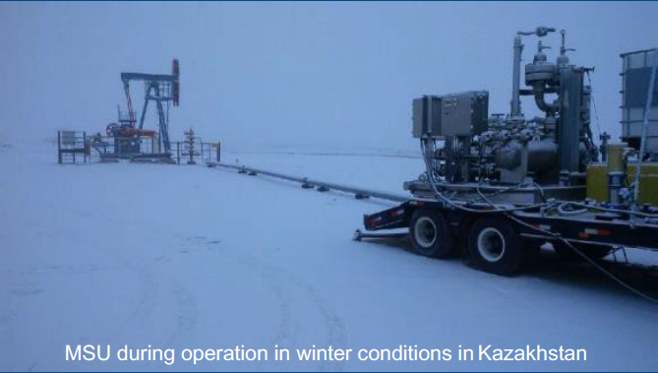
External Environmental Conditions
Freezing Point of 50% H₂O₂ is -52°C (-62°F)
Minimal issues encountered during freezing winter conditions where conventional boilers have to maintain water supply from freezing

